Slide 1
General Assembly Data Science Course
Forecasting the Price of Coffee Using Time-series and Machine Learning Techniques
February 25th, 2018

Slide 2
Agenda
Executive Summary
Problem Overview and the Importance of Coffee
Variable Analysis
Solution and Impact Discussion
Next Steps

Slide 3
Executive Summary
Hypothesis
Test whether coffee prices can be accurately predicted
Problem Overview and Importance of Coffee: Globally, coffee is a massive market with several key players including companies, governments, and NGOs
Variable Analysis: The price of coffee is highly correlated with other commodities and recent values of itself. It also displays stationarity.
Solution and Impact Discussion: Results show that the random forest model performs much better than the ARIMA model but only slightly better than the benchmark carry forward model.
Next Steps: Acquiring weather data from key coffee exporters combined with using more sophisticated modeling techniques (e.g., XGBoost) will likely significantly enhance the model's performance.
Source: Macrotrends.net; Internal Analysis

Slide 4
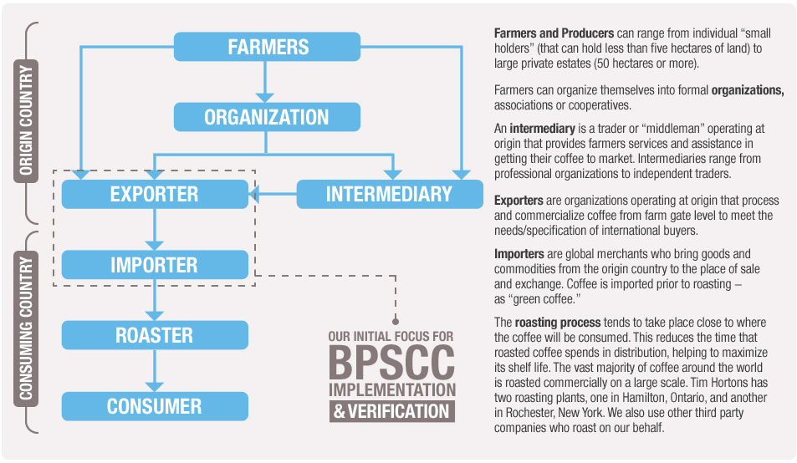
Problem Overview and Importance of Coffee The coffee market is sized in the billions and contains several key actors across the value chain
Fast Facts
Origin | According to legend, back in 800 A.D., goat herders noticed the effect coffee beans had on their animals and they decided to make a drink out of it
Robusta vs. Arabica | Arabica is more popular while Robusta is more bitter and has more caffeine
Name | The word coffee comes from the Arabic word “wine”
Coffee Value Chain
Top 2018 Coffee Exporters
($B)
Brazil
Vietnam
Germany
Colombia
Switzerland
Constructing an accurate model to forecast the price of coffee would help several key players in the market
Source: Macrotrends.net; World’s Top Exports; Internal Analysis

Slide 5
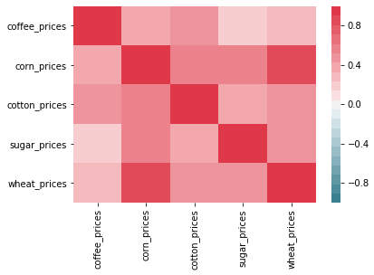
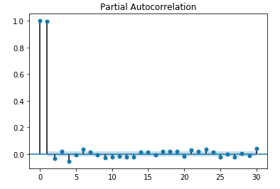
Variable Analysis The price of coffee is highly correlated with other commodities and recent values of itself
Feature Variables Correlation Matrix
Partial Autocorrelation of the Price of Coffee
Past 2 days are highly correlated with the current price of coffee however, there is no significant relationship after 2 days
Source: Macrotrends.net; Internal Analysis

Slide 6
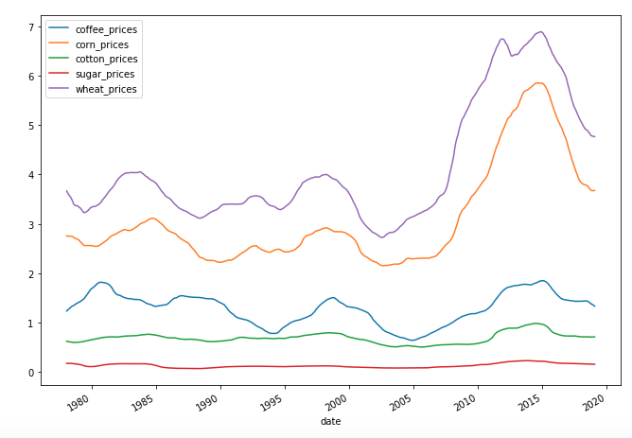
Variable Analysis Coffee has remained relatively stable of the past 30+ years and does not show any significant trend
Moving Average of Commodity Prices
(by 1-year)
Coffee displays stationarity i.e. its mean, variance, and autocorrelation are all relatively stable over time; changes in price are primarily driven by changes in weather patterns
The data profile of the price of coffee informed the analytical techniques implemented
Source: Macrotrends.net; Internal Analysis

Slide 7
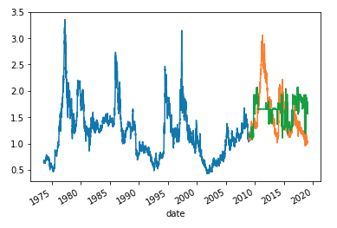
Solution & Impact Discussion Random Forrest Regressor only slightly outperformed the benchmark carry forward method
Historic Coffee Prices, Actual vs. Predicted
(Random Forrest Regressor)
Model Performance
and Notes
Actual Price
Predicted Price
Test Period: 2009 – 2019 used to test the data because allows the model to see the full cyclical nature of coffee price while also giving it ample amount of data to train
RMSE Performance: Random Forest Regressor only slightly outperforms the carry forward benchmark (.47 RMSE vs. .44 RMSE)
ARIMA Use: Autoregressive integrated moving average performs poorly on the model
Source: Macrotrends.net; Internal Analysis

Slide 8



Next Steps Enhancing the model with additional data and more sophisticated algorithms will allow it to be tested on futures contracts
+
Brazil accounts for over 1/3 of global coffee production and shifts in the weather patterns can lead to significant changes in the price of coffee
XGBoost is a more robust version of the simplified random forest regressor utilized in this project. Leveraging XGBoost should improve overall results
Once the model is fine tuned, it can be tested on hypothetical future contracts to evaluate whether it can be used for speculation
Are there any other suggestions to improve this project?
Other Questions?
Source: Macrotrends.net; Internal Analysis

